Slide 1


Markets, Prices, Supply, Demand
and Budget Constraint
（宏观经济学的一些微观经济基础）

Slide 2
Markets in the Macroeconomy
Assuming that households perform all of the functions in the economy.
Reprentative households: 宏观经济学使用“代表性家庭”，他的集合就是宏观经济体。
Each household runs a family business and uses labor, L, and capital, K, to produce goods, Y, through the production function.
Y= A· F( K, L)

Slide 3
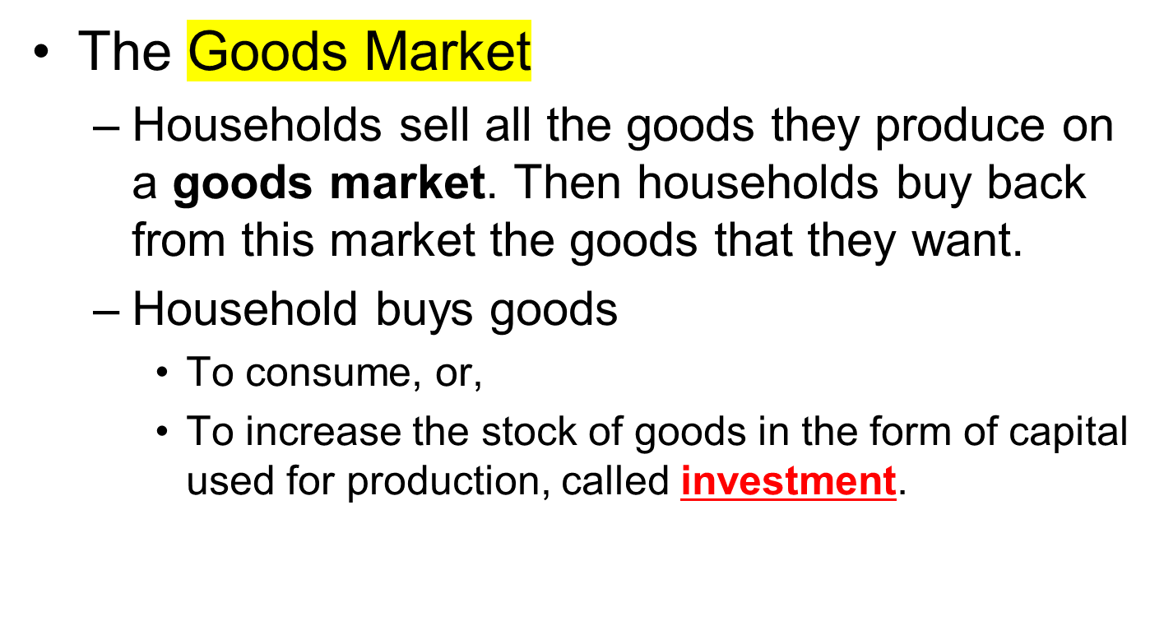
Markets in the Macroeconomy

Slide 4
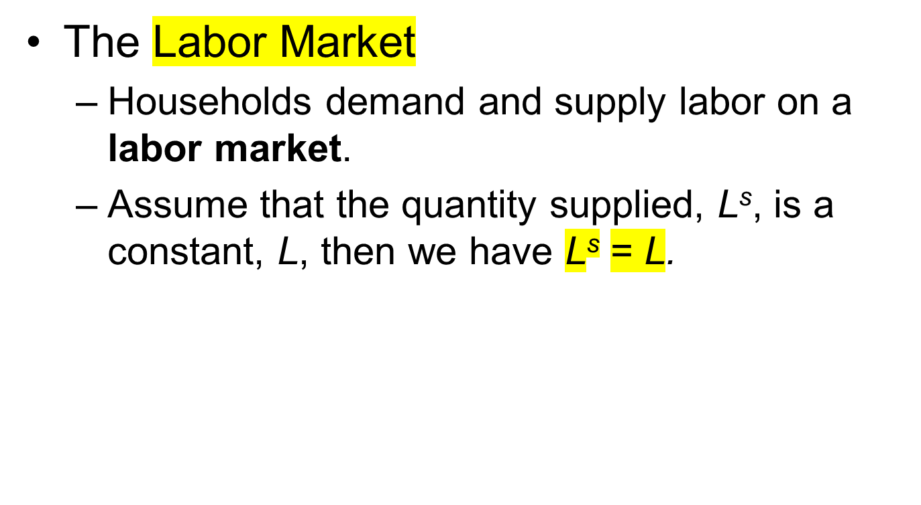
Markets in the Macroeconomy

Slide 5
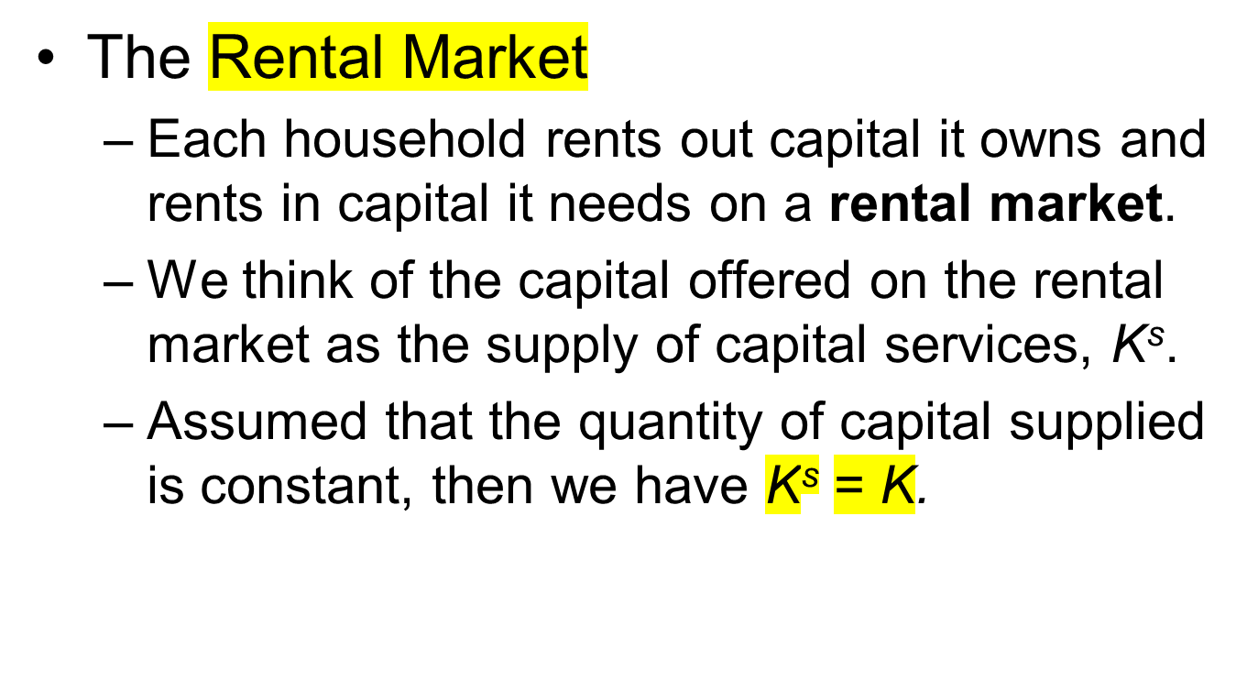
Markets in the Macroeconomy

Slide 6
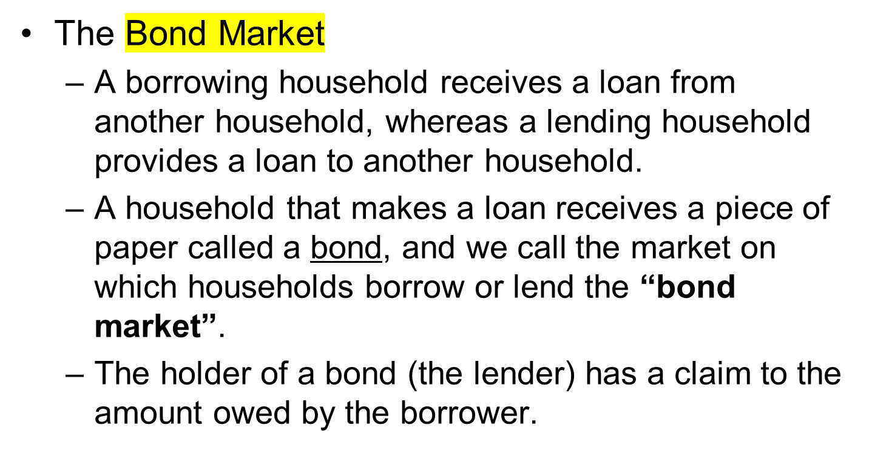
Markets in the Macroeconomy

Slide 7
Markets and Prices
We assume that the exchanges on each of these markets use a single form of medium of exchange.
  A medium of exchange is an object held, not for its own sake, but rather to trade fairly soon for something else, such as goods and services.
  We call the medium of exchange in our model money.
  Money is used to measure Price.

Slide 8
Markets and Prices
The Goods Market
  The price, denoted by P, expresses the number of curreny that exchange for one unit of goods.
  We call P the price level.
  Y= A· F( K, L)
    Since all of these goods are sold on the goods market, the variable Y will also represent the quantity of goods per year sold and bought on the goods market.
    The quantity PY is the nominal value per year of the goods bought and sold on the goods market.

Slide 9
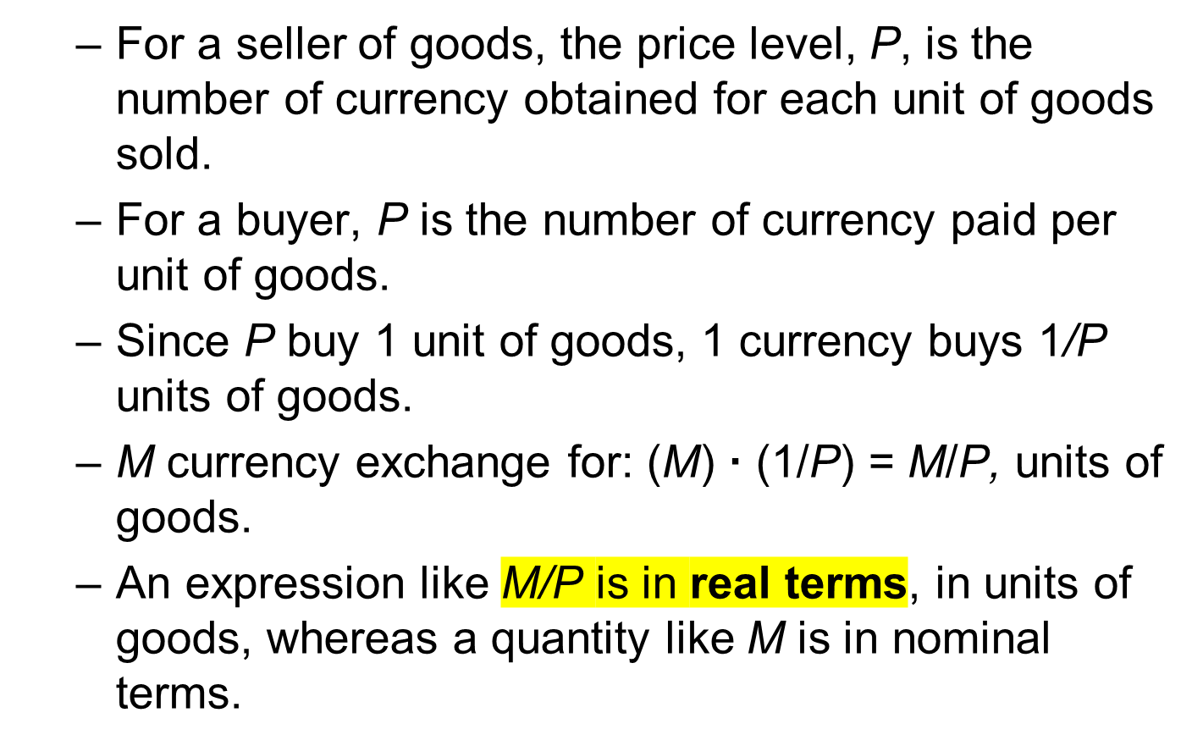
Markets and Prices

Slide 10
Markets and Prices
The Labor Market
  Households buy and sell labor in the labor market at the nominal wage rate, w.
  The real wage rate is w/P.

Slide 11
Markets and Prices
The Rental Market
  Households rent out capital, K, for nominal rental price, R
    A household that rents in the amount of capital K^{d} , pays the nominal amount RK^{d} per year, and then use the capital as an input to production.
  The real rental price is R/P.

Slide 12
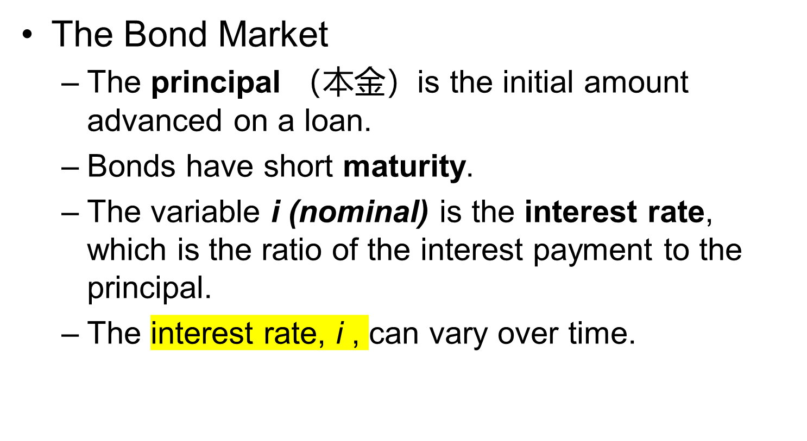
Markets and Prices

Slide 13
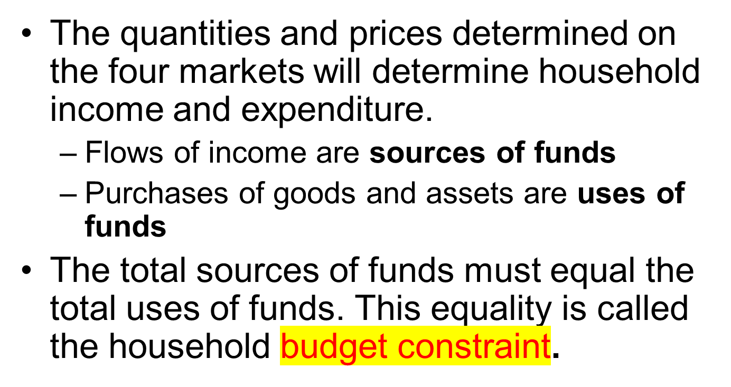
Constructing the Budget Constraint

Slide 14
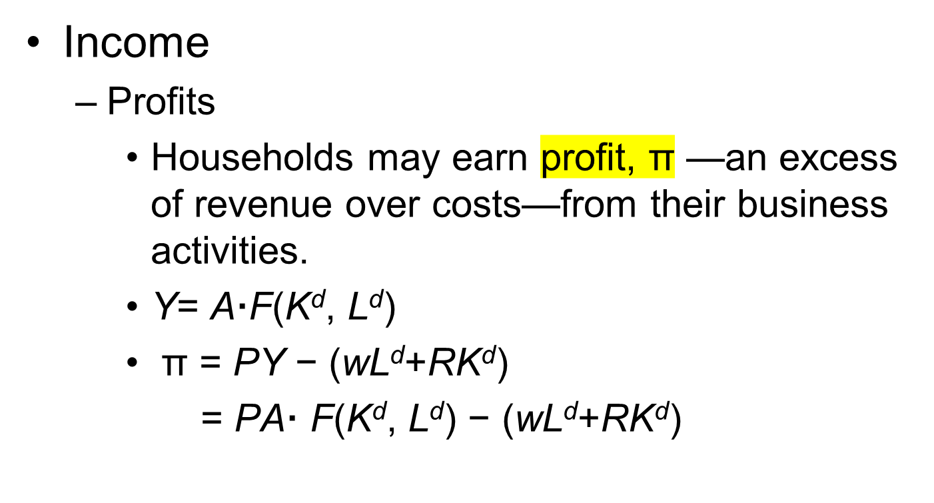
Constructing the Budget Constraint

Slide 15
Constructing the Budget Constraint
  Wage income
    If households supply the quantity of labor L^{s} to the labor market, they receive the nominal wage income of wL^{s} per year.
    Quantity of labor supplied is the fixed amount L, so nominal wage income is wL.

Slide 16
Constructing the Budget Constraint
  Rental income
    If households supply the quantity of capital K^{s} to the rental market they receive the nominal rental income of RK^{s} per year.
    Since the quantity of capital is fixed at K, so that K^{s} = K, the nominal rental income is RK.
    The quantity δK of capital disappears each year. The nominal value of this lost capital is P· δK.

Slide 17
Constructing the Budget Constraint
    Net nominal rental income
    = nominal rental income− value of depreciation
      = RK − δPK
      = (R/P)·P K − δPK
      = (R/P − δ) · PK
    Then, rate of return on owning capital= R/P − δ

Slide 18
Constructing the Budget Constraint
  Interest Income
    If a household’s nominal bond holdings are B, the flow of nominal interest income received is iB per year.

Slide 19
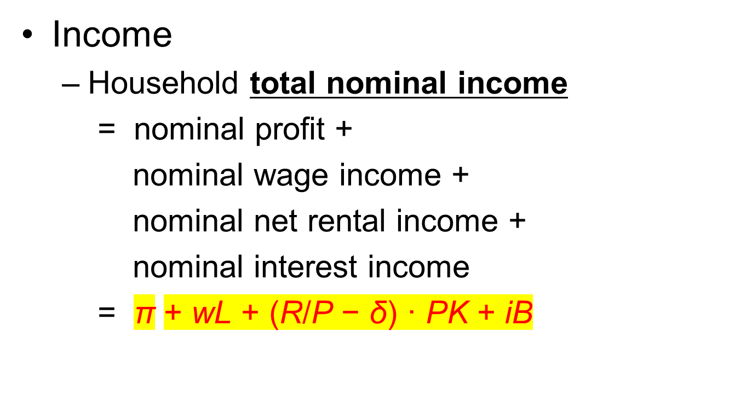
Constructing the Budget Constraint

Slide 20
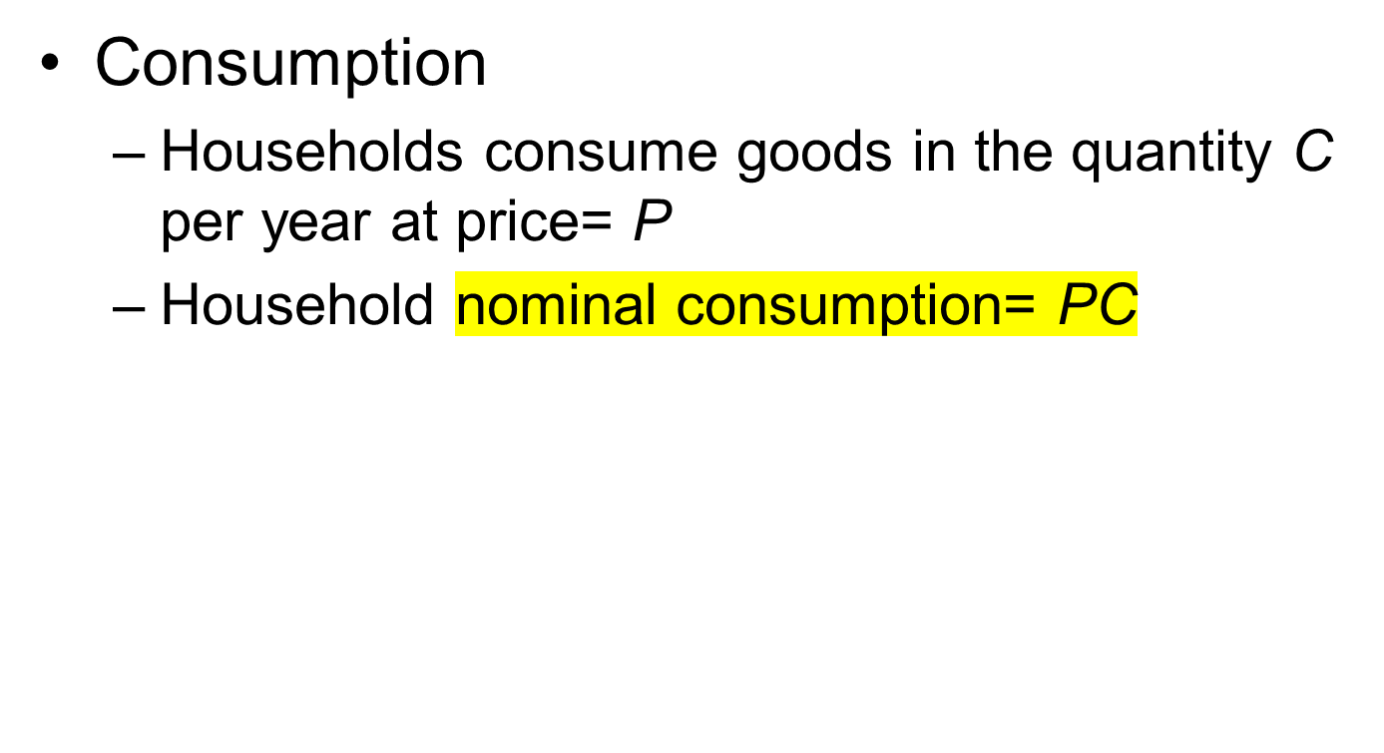
Constructing the Budget Constraint

Slide 21
Constructing the Budget Constraint
Assets
  Households hold assets in three forms:
    Money, M;
    Bonds, B;
    Ownership of capital, K.

Slide 22
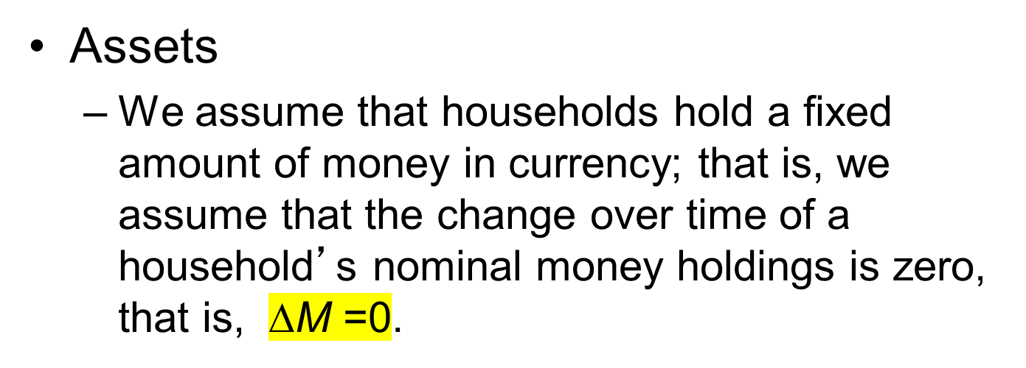
Constructing the Budget Constraint

Slide 23
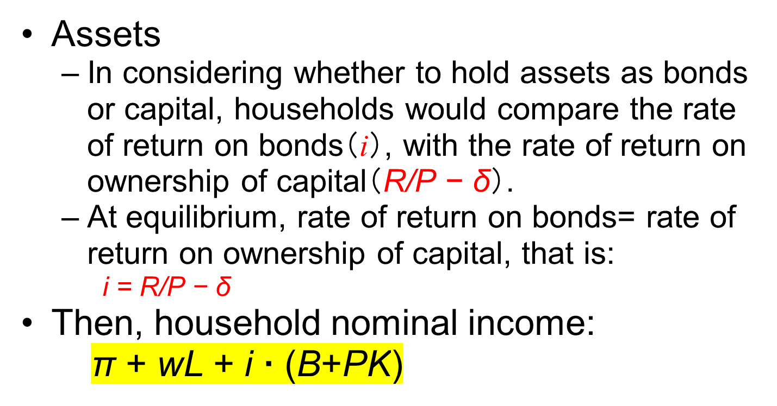
Constructing the Budget Constraint

Slide 24
Constructing the Budget Constraint
Household Budget Constraint
  nominal value of assets= M+ B+ PK
  nominal saving: equals the change over time in the nominal value of assets(储蓄=净投资).
  = (∆nominal value assets) = ∆M + ∆B + P·∆K
  = 0+∆B + P·∆K
  = ∆B + P·∆K

Slide 25
Constructing the Budget Constraint
Household Budget Constraint
  nominal saving （储蓄=收入-消费）
  = nominal income− nominal consumption
  = π + wL+i ·(B+PK)−PC
  that is: ∆B+P·∆K =π+wL+i·(B+PK)−PC
  that is: PC+∆B+P·∆K =π+wL+i·(B+PK)
  nominal consumption+nominal saving
  = nominal income （消费+储蓄=收入）

Slide 26
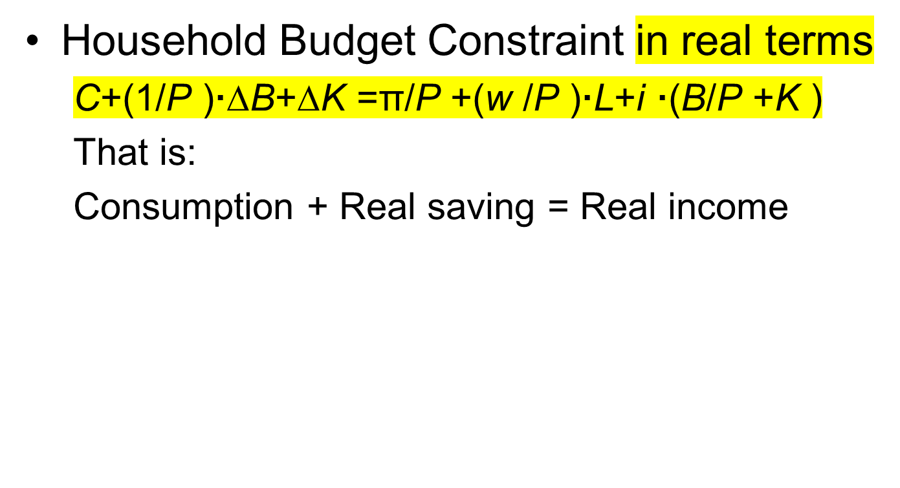
Constructing the Budget Constraint

Slide 27
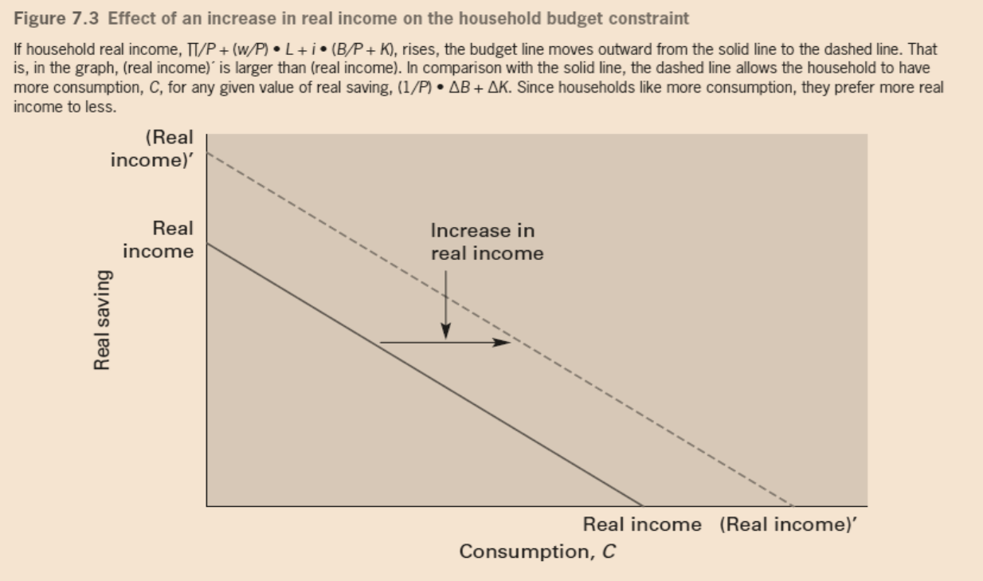
Constructing the Budget Constraint

Slide 28
Clearing of the Markets for labor and Capital Services
Profit Maximization
  Nominal Profit
    π =PA· F(K^{d}, L^{d}) − (wL^{d}+RK^{d})
  Real Profit
    π/P = A·F(K^{d}, L^{d}) − (w/P) · L^{d} − (R/P) · K^{d}
    =output −real wage payments−real rental payments

Slide 29
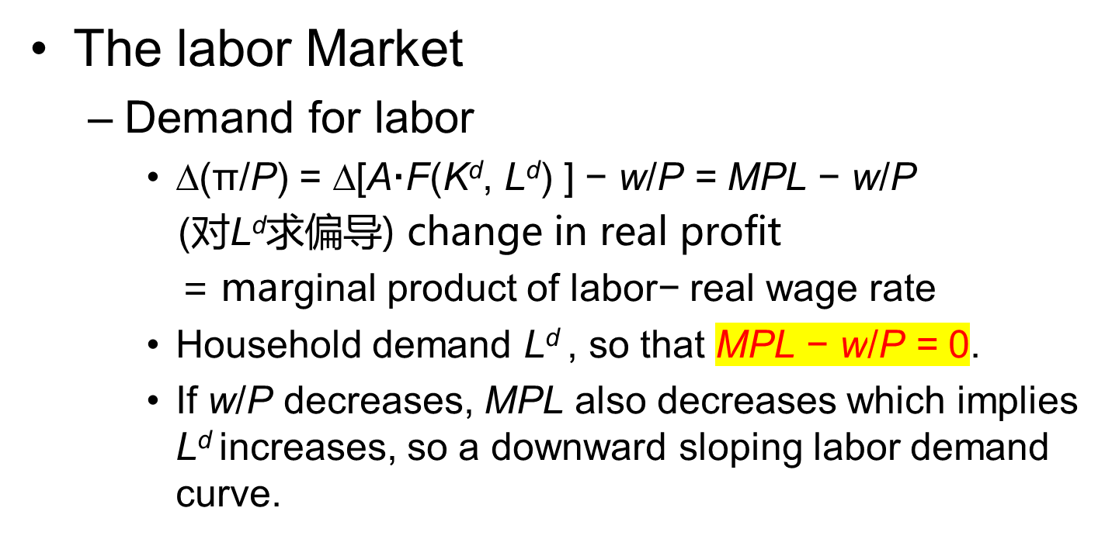
Clearing of the Markets for labor and Capital Services

Slide 30
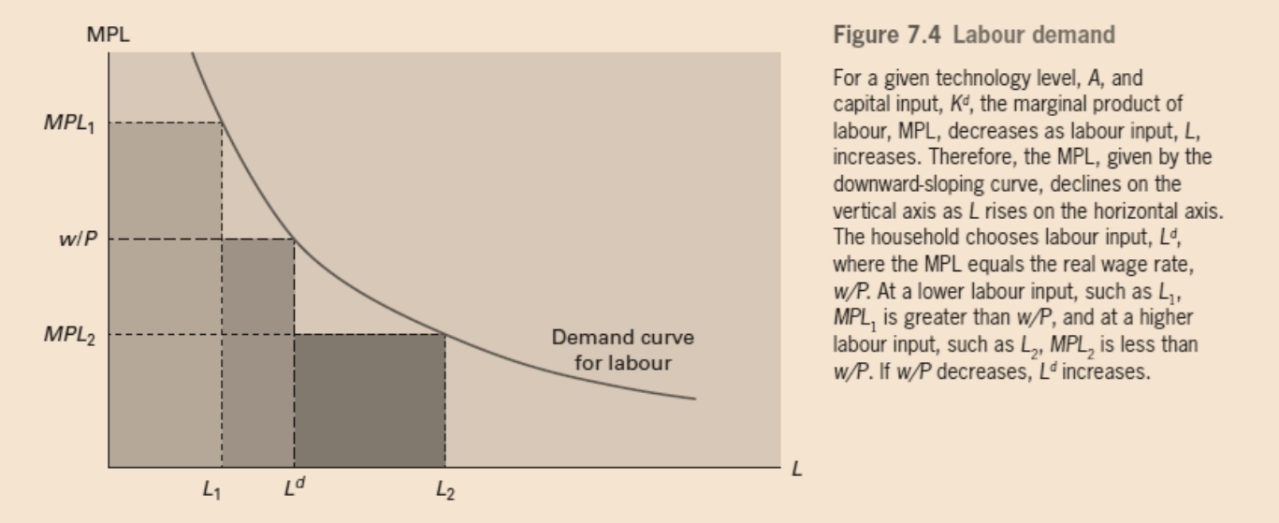
Clearing of the Markets for labor and Capital Services

Slide 31
Clearing of the Markets for labor and Capital Services
  Supply of labor
    We are assuming the aggregate or market supply of labor, L^{s}, is the given amount L.

Slide 32
Clearing of the Markets for labor and Capital Services
  Clearing of the labor market
    w/P is determined to equate the aggregate quantity of labor demanded, L^{d}, to the aggregate quantity supplied, L.
    (w/P)* = MPL ( evaluated at L)

Slide 33
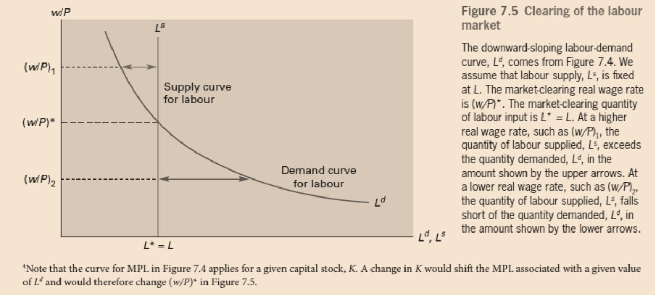
Clearing of the Markets for labor and Capital Services

Slide 34
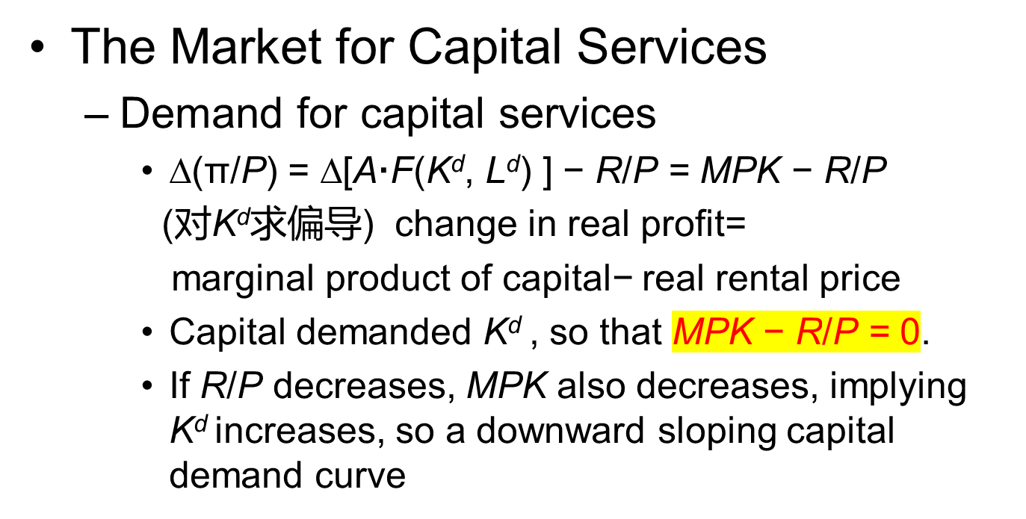
Clearing of the Markets for labor and Capital Services

Slide 35
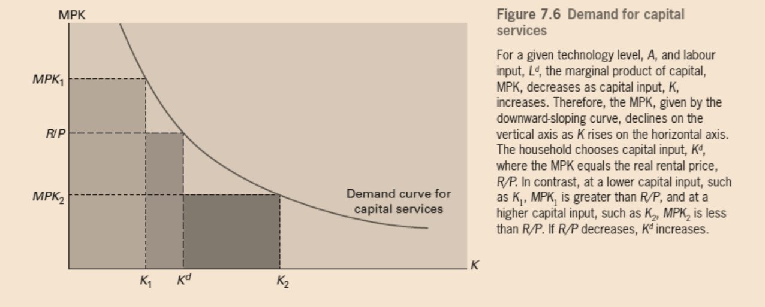
Clearing of the Markets for labor and Capital Services

Slide 36
Clearing of the Markets for labor and Capital Services
The Market for Capital Services
  Supply of capital services
    For the economy as a whole, the aggregate quantity of capital, K, is given from past flows of investment.
    In the short run, the aggregate or market quantity of capital services supplied, K^{s}, equals K.

Slide 37
Clearing of the Markets for labor and Capital Services
The Market for Capital Services
  Clearing of the market for capital services
    R/P will be determined to clear the market—that is, so that the aggregate quantity of capital services supplied, K, equals the aggregate quantity demanded, K^{d}
    (R/P)* = MPK( evaluated at K)

Slide 38
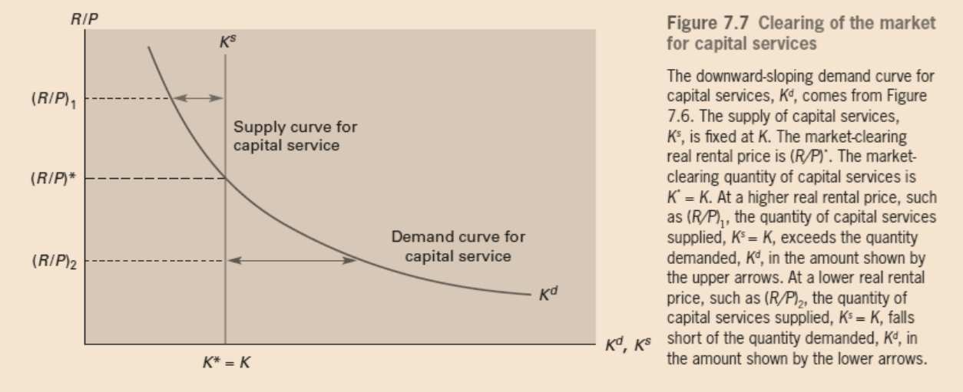
Clearing of the Markets for labor and Capital Services

Slide 39
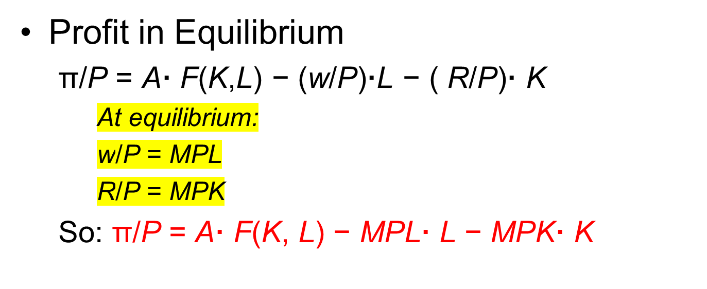
Clearing of the Markets for labor and Capital Services

